Slide 1
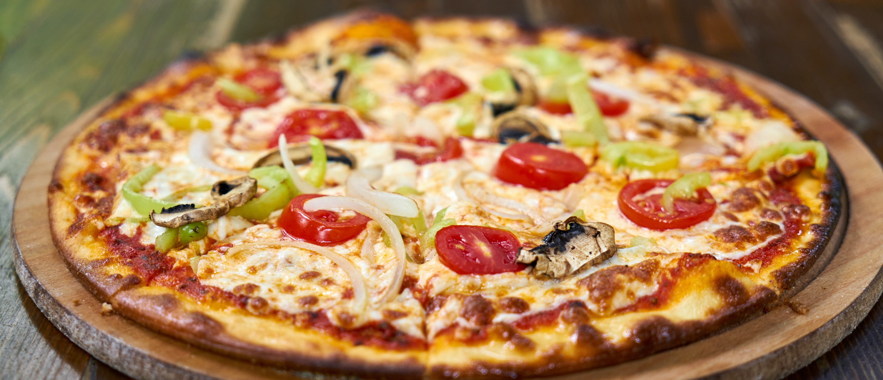
PIZZA PLACE SALES

Slide 2

ABOUT DATASET
A year's worth of sales data from customer insights are given from a fictitious pizza place. The problem can be solved by taking use of excel and also use of Pivot table . Which helps us to more understandable the data. From this data we also see the seasonal growth of the sales. and also see the total revenue of the sales. And also very useful to know that which pizza product needs more promotion.

Slide 3

DATA INFORMATION
TABLE | FIELD | DESCRIPTION
Orders | Order_Id | Unique identifier for each order placed by a table
Orders | Date | Date the order was placed (entered into the system prior to cooking & serving)
Orders | Time | Time the order was placed (entered into the system prior to cooking & serving)
The dataset contains around 48,260 rows and 15 column.
TABLE | FIELD | DESCRIPTION
Orders_details | Order_details_Id | Unique identifier for each pizza placed within each order (pizzas of the same type and size are kept in the same row, and the quantity increases)
Orders_details | Order_Id | Foreign key that ties the details in each order to the order itself
Orders_details | Pizza_Id | Foreign key that ties the pizza ordered to its details, like size and price
Orders_details | Quantity | Quantity ordered for each pizza of the same type and size

Slide 4
TABLE | FIELD | DESCRIPTION
Pizzas | Pizza_Id | Unique identifier for each pizza (constituted by its type and size)
Pizzas | Pizza_type_ Id | Foreign key that ties each pizza to its broader pizza type
Pizzas | Size | Size of the pizza (Small, Medium, Large, X Large, or XX Large)
Pizzas | Price | Price of the pizza in USD
TABLE | FIELD | DESCRIPTION
Pizzas_types | Pizzas_types_Id | Unique identifier for each pizza type
Pizzas_types | Name | Name of the pizza as shown in the menu
Pizzas_types | Category | Category that the pizza fall under in the menu (Classic, Chicken, Supreme, or Veggie)
Pizzas_types | Ingredients | Comma-delimited ingredients used in the pizza as shown in the menu

Slide 5
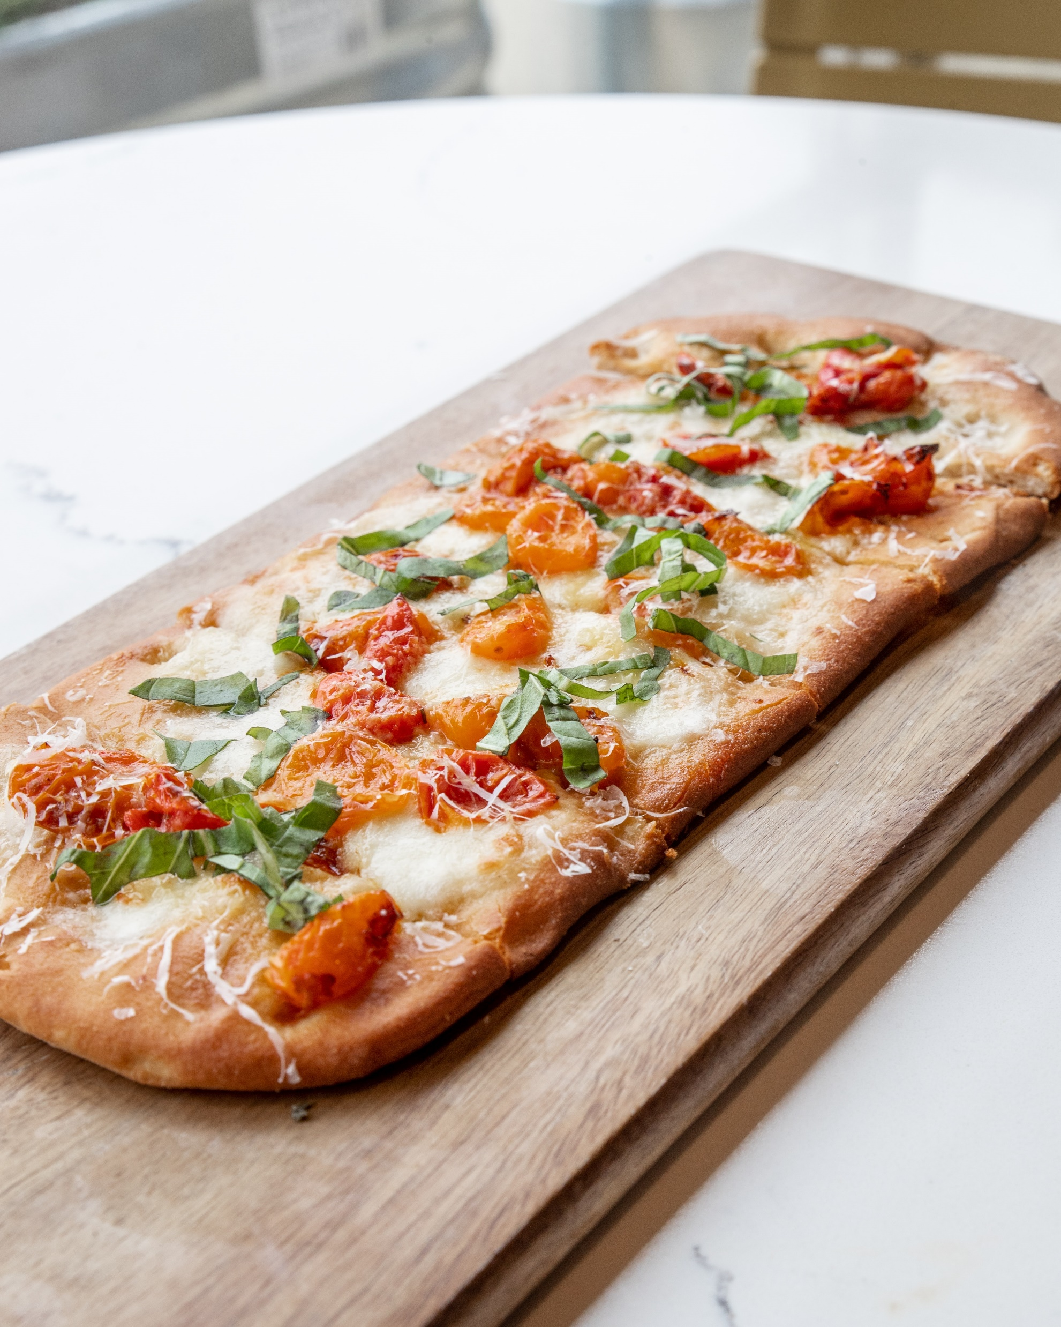
METHODOLOGY AND PROJECT SCOPE
STEP 1
Firstly, Arrange the data in single Workbook, without understanding the data
STEP 2
For execution of calculations part we need to arrange the data , which collects the data for customer orders details, pizzas types, date, time, size and price of pizzas and then, calculations are carried out on excel.
STEP 3
After that we used the pivot table from it and use excel functions to solved the calculation part and then create a understanding pivot charts for the recommended analysis part of this project to provide solution.

Slide 6
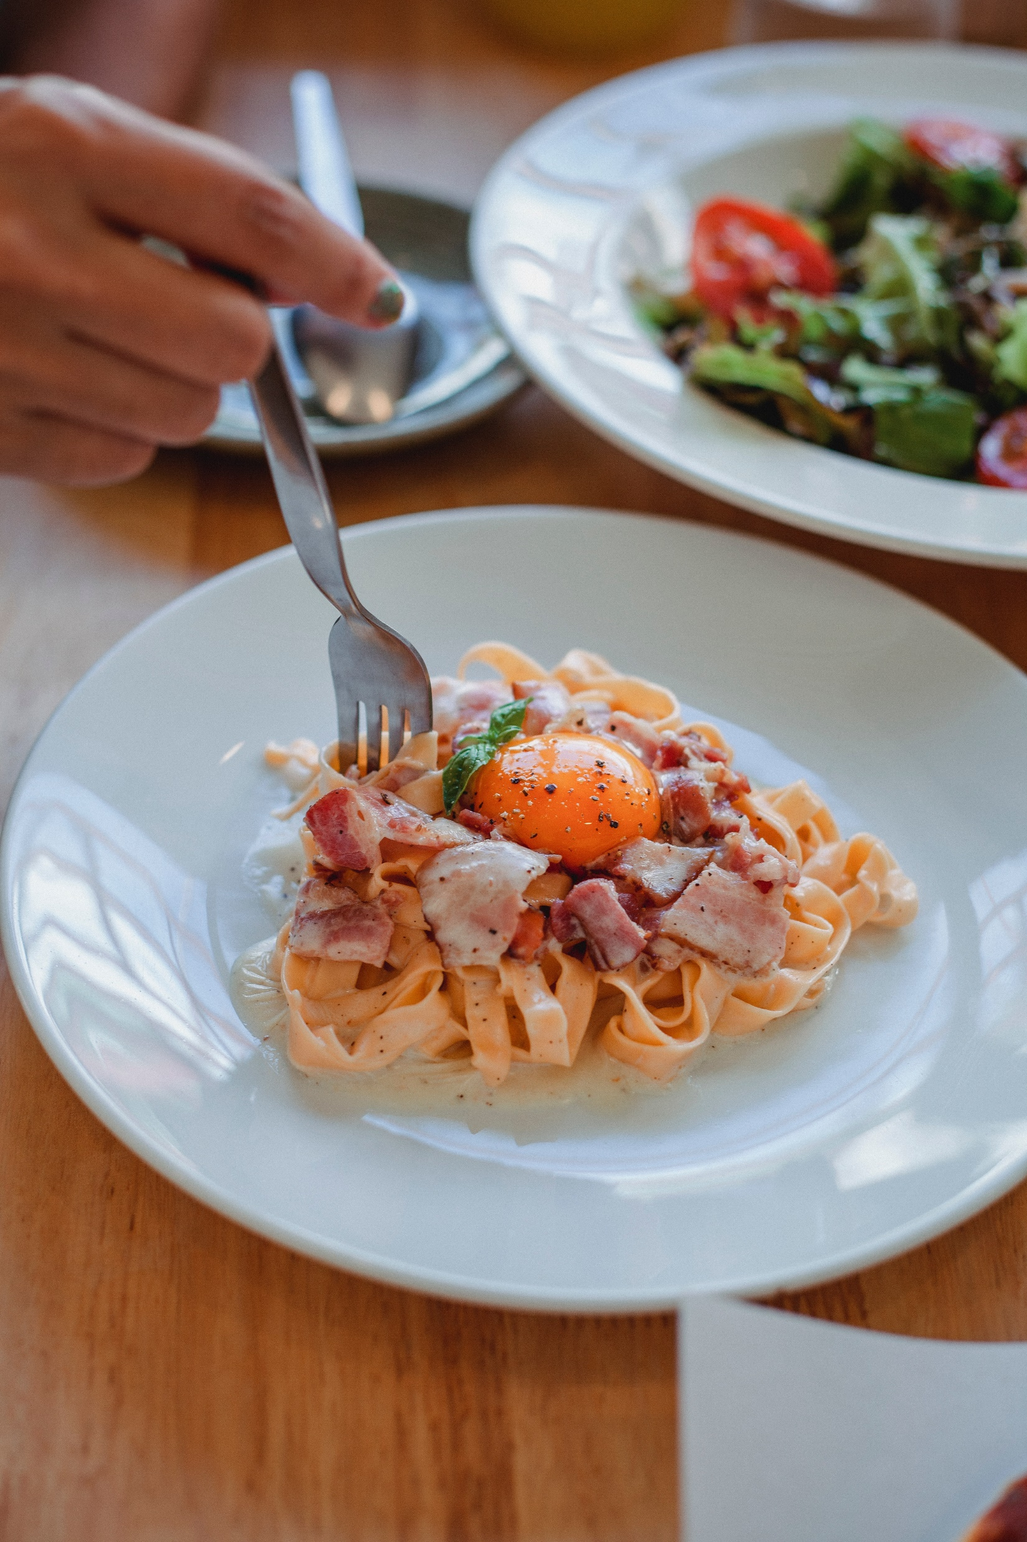
STEP 4
At last a dashboard is prepared in which all the recommended analysis part is calculated.

Slide 7
1. HOW MANY CUSTOMERS DO WE HAVE EACH DAY ?
01 -We would choose the "Orders" dataset for this question, with two columns: “Order_Id” & “Date”.
02- Select these two columns to insert a Pivot table. Drag "Date" into the Row Labels section and "Order_Id" into the values section.
03 –As a result, we would obtain the total number of orders placed by customers on that specific date by its “COUNT” function. Then, select both the column & create a pivot chart.
04- Therefore, from the pivot chart, we can say that we have around 60-65 customers each day.

Slide 8
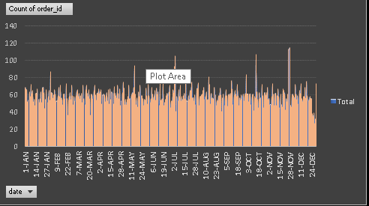

Slide 9
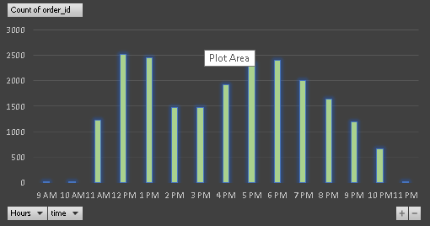
ARE THERE ANY PEAK HOURS ?
01- We would choose the "Orders" dataset again for this subquestion, with one column: “Time”.
02-Select this one column to insert a Pivot table. Drag “Time" into the Row Labels section and again drag “Time" into the values section.
03- As a result, we would obtain the count of time at particular hours. Then, select both the column and create a pivot chart.
04- Therefore, from the pivot chart, we can say Peak hours are between : 12 pm - 1 pm & 5 pm - 7 pm.

Slide 10
2. HOW MANY PIZZAS ARE TYPICALLY IN ORDER? DO WE HAVE ANY BESTSELLERS ?
01- We would choose the "Order_details" dataset for this question, with three columns: “Order_details_id”, “Order_Id” & “Pizza_Id”.
02- Select these three columns to insert a Pivot table. For pizzas order typically by any customer is drag “Order_id" into the Row Labels section and "Order_details_Id" into the values section whereas for bestseller drag “Pizza_Id” into the Row Labels section and "Order_Id" into the values section.
03- As a result, we would obtain the total number of pizzas been typically in order by using “COUNT” & “AVERAGE” function by customers whereas for bestseller we would use “MAX” function.
04- Select the specific columns for particular question. Therefore, from the pivot chart, we can say that there are 3 pizzas in order and the bestseller is “Big_Meat_S”.

Slide 11
3. HOW MUCH MONEY DID WE MAKE THIS YEAR ? CAN WE IDENTIFY ANY SEASONALITY IN THE SALES ?
01- We would choose the "Order" dataset for seasonality question, with two columns: “Order_Id” & “Date” and for revenue we would choose “Pizzas” dataset with two columns : “Pizza_Id” & “Pizza_type_Id”
02- Select these columns to insert a Pivot table. For revenue, drag “Pizza_Id” into the Row Labels section and values section whereas for seasonality, drag “Date" into the Row Labels section and "Order__Id" into the values section.
03- As a result for revenue, we would obtain the total number of count of pizza_Id to which we will multiply with the price by using “SUMPRODUCT” function whereas for seasonality result, we would use value field setting for %column total.
04- Select the specific columns for particular question. Therefore, in year 2015, total revenue of 8,01,945 USD was generated and from the pivot chart, we can say that OctNov-Dec months were found to be seasonality in sales.

Slide 12
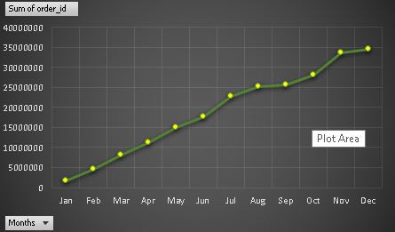

Slide 13
4. ARE THERE ANY PIZZAS WE SHOULD TAKE OFF THE MENU, OR ANY PROMOTIONS WE COULD LEVERAGE?
01- We would choose the "Order_details" dataset for this question, with two columns: “Order_Id” & “Pizza_Id”.
02- Select these two columns to insert a Pivot table. Drag “Pizza_Id" into the Row Labels section and "Order_Id" into the values section.
03- As a result, we would use “MIN” function to better sort out the pizzas from lower to higher no. of sales. Then, select both the column and create a pivot chart.
04- Therefore, from the pivot chart, the light color bar graph shows the minimum sales of pizzas which is in between range of 0-500. Therefore, for these type of pizzas we could leverage the promotions or should take off from the menu.

Slide 14
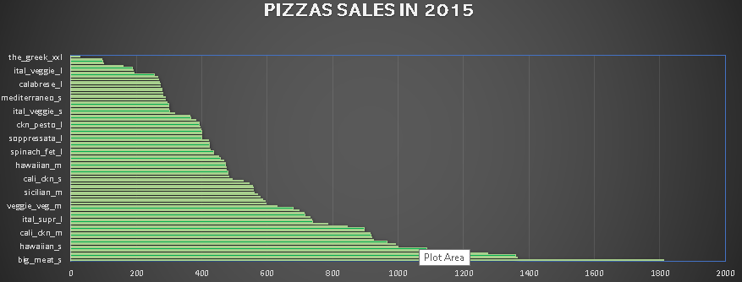

Slide 15

GOALS & KPIs
Goal 1: Data understandable.
Goal 2: Calculate the peak hours, bestsellers and seasonality of pizzas from the data.
Goal 3: Calculate the revenue of any pizza place from its sales data.
EXCEL CONCEPTS USED
Concept 1: COUNT, AVERAGE
Concept 2: SUMPRODUCT
Concept 3: NESTED SORTING
Concept 4 : NESTED FILTER
Concept 5: PIVOT TABLE, GROUPING
Concept 6: MAX, MIN

Slide 16
CONCLUSION
From this data it helps us to understand that which pizza is popular and which pizza is not popular . Also this data set is very useful for the business for generating the more profit . and aslo used this data to identified which pizza product should promote

Slide 17
THANK YOU
PROJECT OWNER :
SHUBHAM KOUNDAL

